Slide 1
Analysis of Hypothyroidism via Machine Learning Algorithms
Abhi, Caroline, Lindsey, Srija, William

Slide 2
Why is this Important?

Slide 3
Main Factors Causing Hypothyroidism

Slide 4
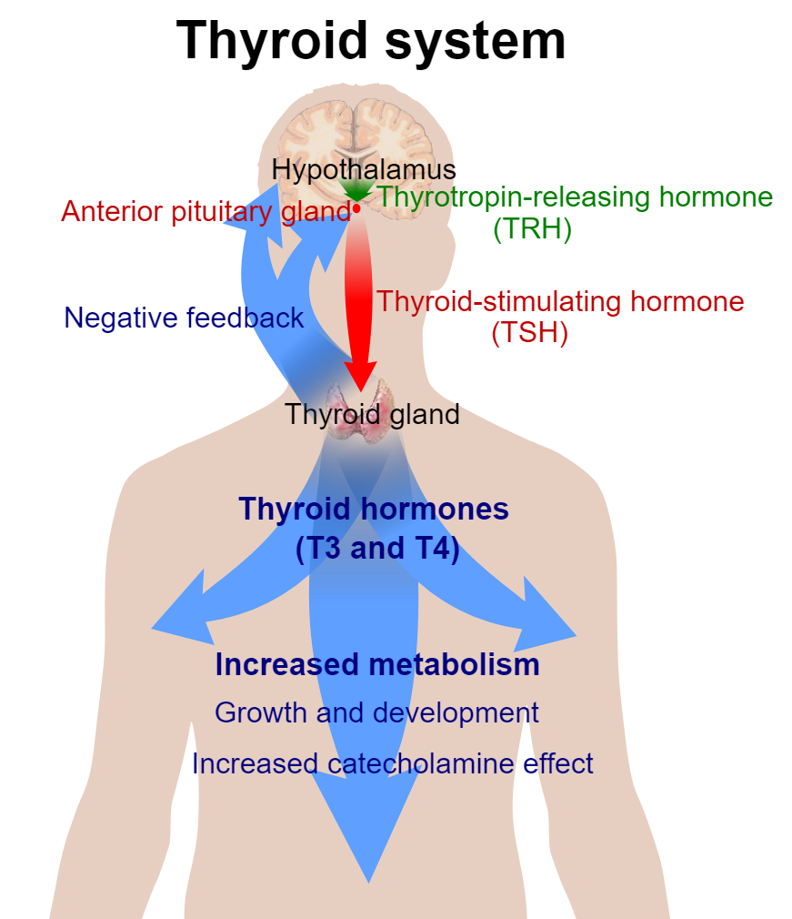
TSH
Higher->Activity

Slide 5
T4
Higher->Dormancy
Measured by TT4

Slide 6
T3
Converted from T4 at tissue

Slide 7
Models Considered
Notes:
Binary - SVM, Decision Trees, Random Forest
Began by trying an SVM model. Played around with various gamma values and determined an optimal value. Obtained a solid AUC.
Tried Decision Trees and liked them for their interpretability. Obtained stellar AUC with six features and pondered whether it was overfitting, and realized that the data was biased. Worked really well!
Multiclass - SVM, Decision Trees, Random Forest

Slide 8
Code Explanation

Slide 9
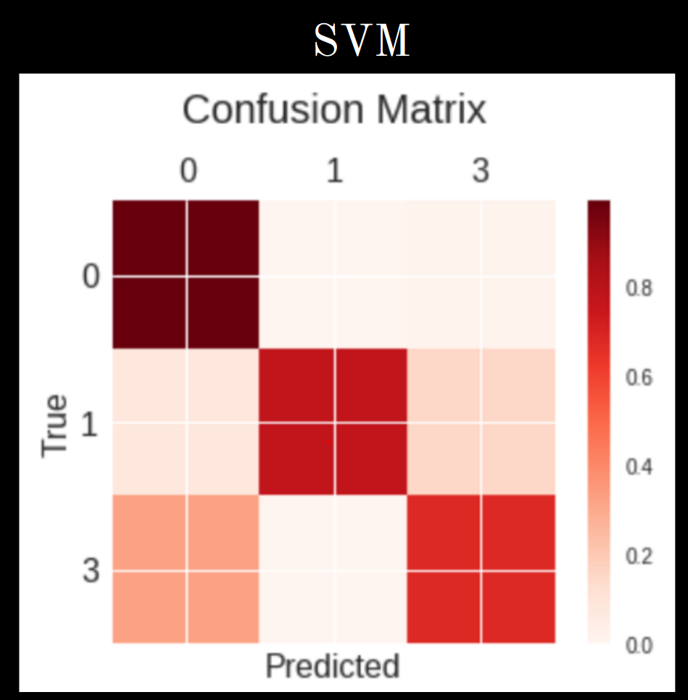
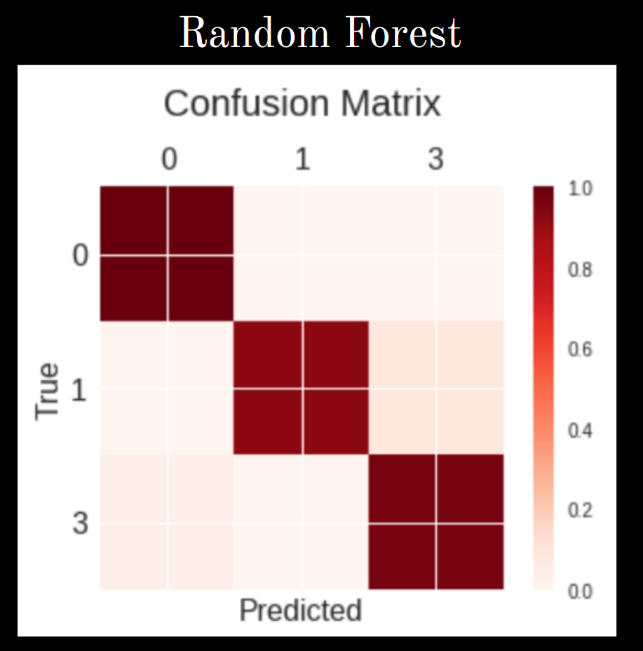
Multi-class Confusion Matrices

Slide 10
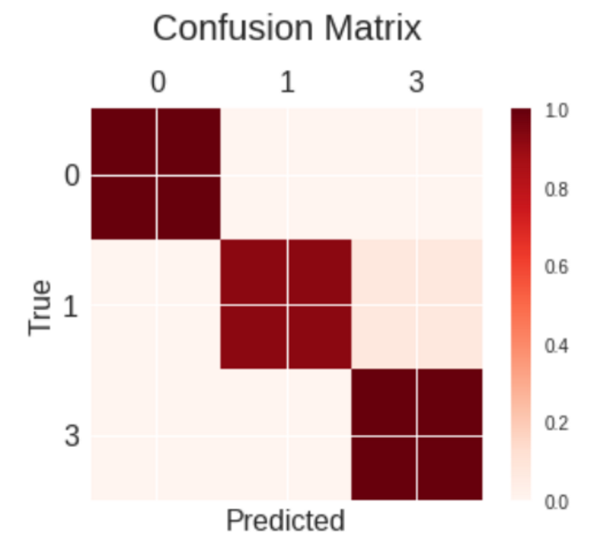
Decision Tree Confusion Matrix
Decision Tree

Slide 11
What features did our algorithm choose?

Slide 12
Which model is optimal?

Slide 13
Conclusion

